Slide 1
Agentic AI Hackathon: Building Intelligent Agents with IBM Granite and LangFlow
AI-Based Crop Health Monitoring and Advisory System

Slide 2
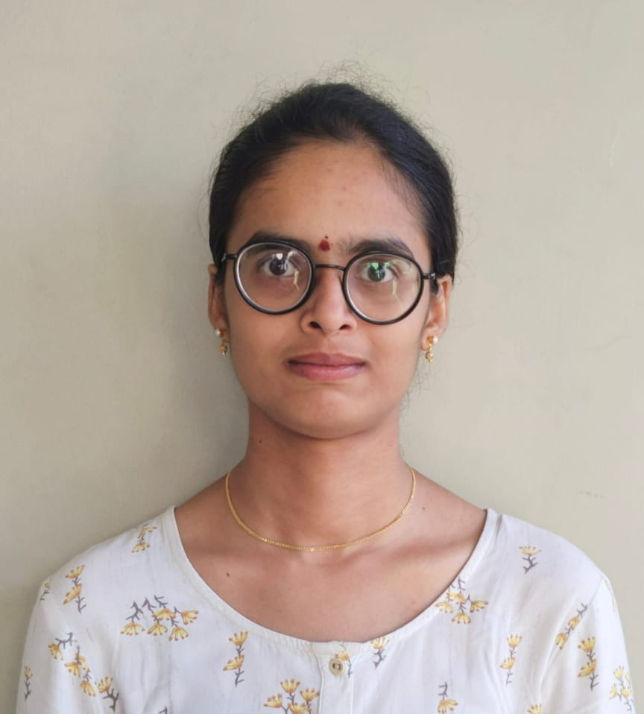
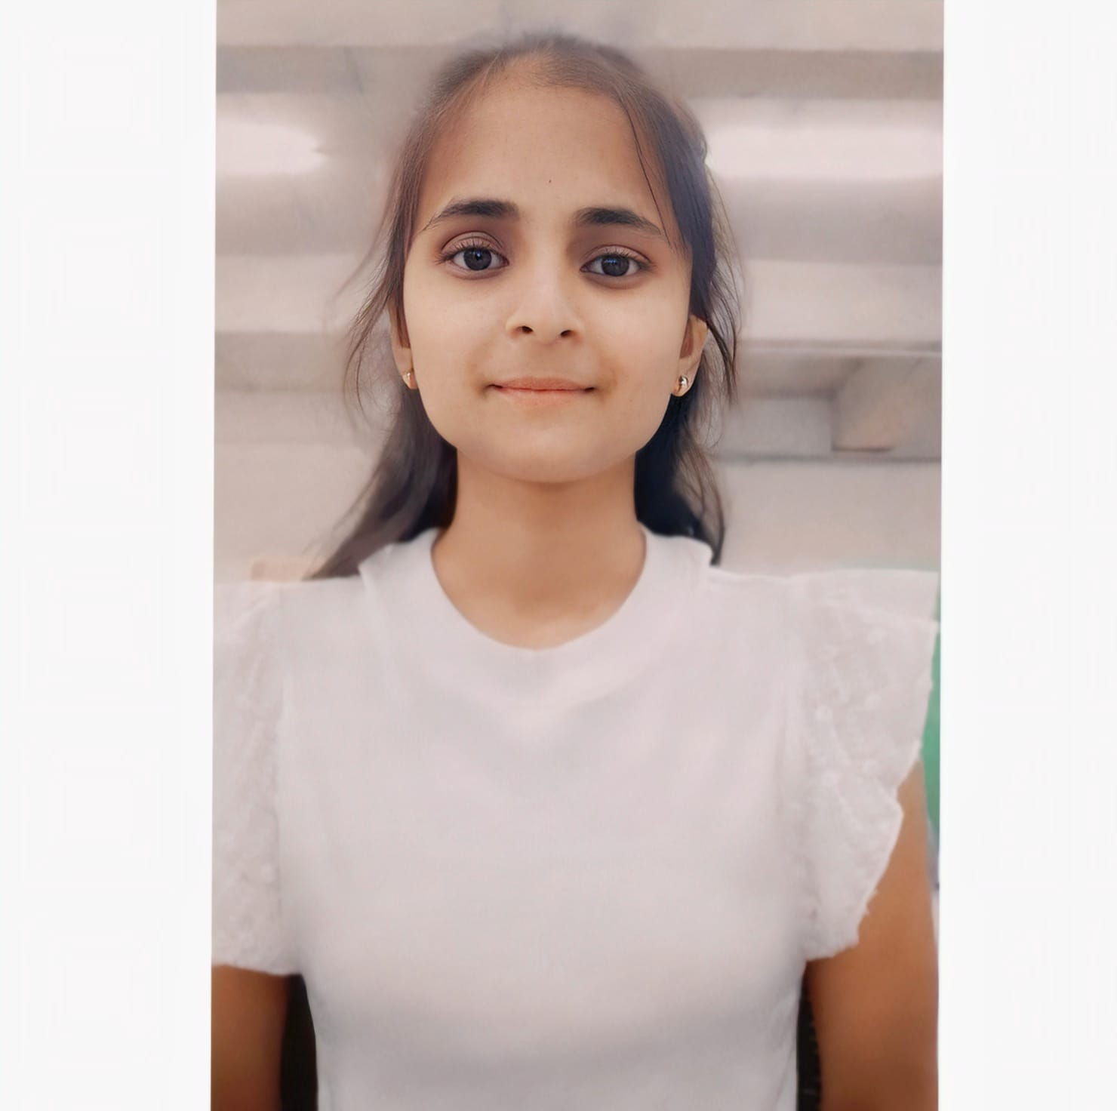
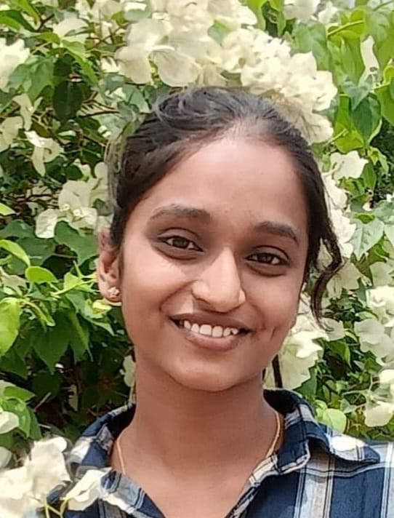
Name of the team: Agro AI
Details of Team members
TEAM MEMBER NAME | Recent Passport Photo | Email ID | Phone number [WhatsApp]
Dadam Tejaswini |  | Tejaswini.mca25@bmsce.ac.in | 9100925720
Beldona Anupama |  | Anupama.mca25@bmsce.ac.in | 9505384485
Bhoomika Mane |  | bhoomika.mca25@bmsce.ac.in | 8123243573

Slide 3
Problem statement
Problem Statement 11: AI-Based Crop Health Monitoring and Advisory System
The Challenge
Crop health is influenced by multiple factors such as soil conditions, weather patterns, pest activity, and irrigation practices. Farmers often rely on periodic field inspections and experience-based judgment, which may delay the identification of early crop stress. Manual analysis of multi-source agricultural data is not scalable, leading to reduced yield and increased input costs. There is a need for an intelligent assistive system that can continuously analyze crop-related data and provide early insights into potential crop health issues.
Agricultural Data Analysis Agent
An agent that ingests soil moisture levels, temperature, humidity, crop growth stage data, and weather forecasts, organizing them into meaningful crop health trends.
Risk Trend Detection Agent
An agent that analyzes short-term and long-term patterns to identify early signs of crop stress, pest risk, or adverse growing conditions using historical data and agronomic thresholds.
Advisory & Best-Practice Assistant
An agent that generates early alerts and provides agronomy-aligned advisories
(assistive only, non-prescriptive).
Outcome
Supports early identification of crop health risks, improves farm decision awareness, and promotes sustainable crop management.
Mandatory Tech Stack
Lang Flow using IBM Granite Model
(Using RAG on agronomy guidelines, crop management best practices, and trusted agricultural references).

Slide 4
Proposed solution
We propose an AI-Based Crop Health Monitoring and Advisory System using an Agentic AI architecture with Langflow and IBM Granite LLM.The system analyzes crop details, soil condition, and weather data to identify early signs of crop stress or disease.Intelligent agents detect risk trends and generate early alerts, while the advisory agent provides assistive, non-prescriptive recommendations based on agronomy best practices using RAG.This enables timely, data-driven decision support for farmers.

Slide 5
Need of project
Farmers often rely on manual inspections and experience-based decisions, which can delay the detection of crop health issues.With increasing climate variability and complex agricultural data, there is a need for an intelligent system that continuously analyzes crop, soil, and weather information.This project helps in early identification of crop health risks, reduces yield loss, and promotes sustainable and cost-effective farming practices.

Slide 6
End user of project
Farmers
Agricultural Officers
Agronomy Consultants
Smart Farming Platforms
Government & Agricultural Agencies

Slide 7
Technology Used
Langflow platform
Langflow component name – Agent , Chat input , Chat output
IBM Grainte model - for eg – ibm-granite-3-2-8b
IBM Cloud
RAG if used
IBM Watsonx.ai
Watsonx

Slide 8
Novelty and Uniqueness
· First platform merging micro‑climate sensing, GenAI, and policy retrieval for urban adaptation.
· Uses non‑wearable, rooftop nodes—cheaper and easier to deploy city‑wide.
· Granite‑guarded outputs ensure bias‑free, regulation‑compliant advice.

Slide 9
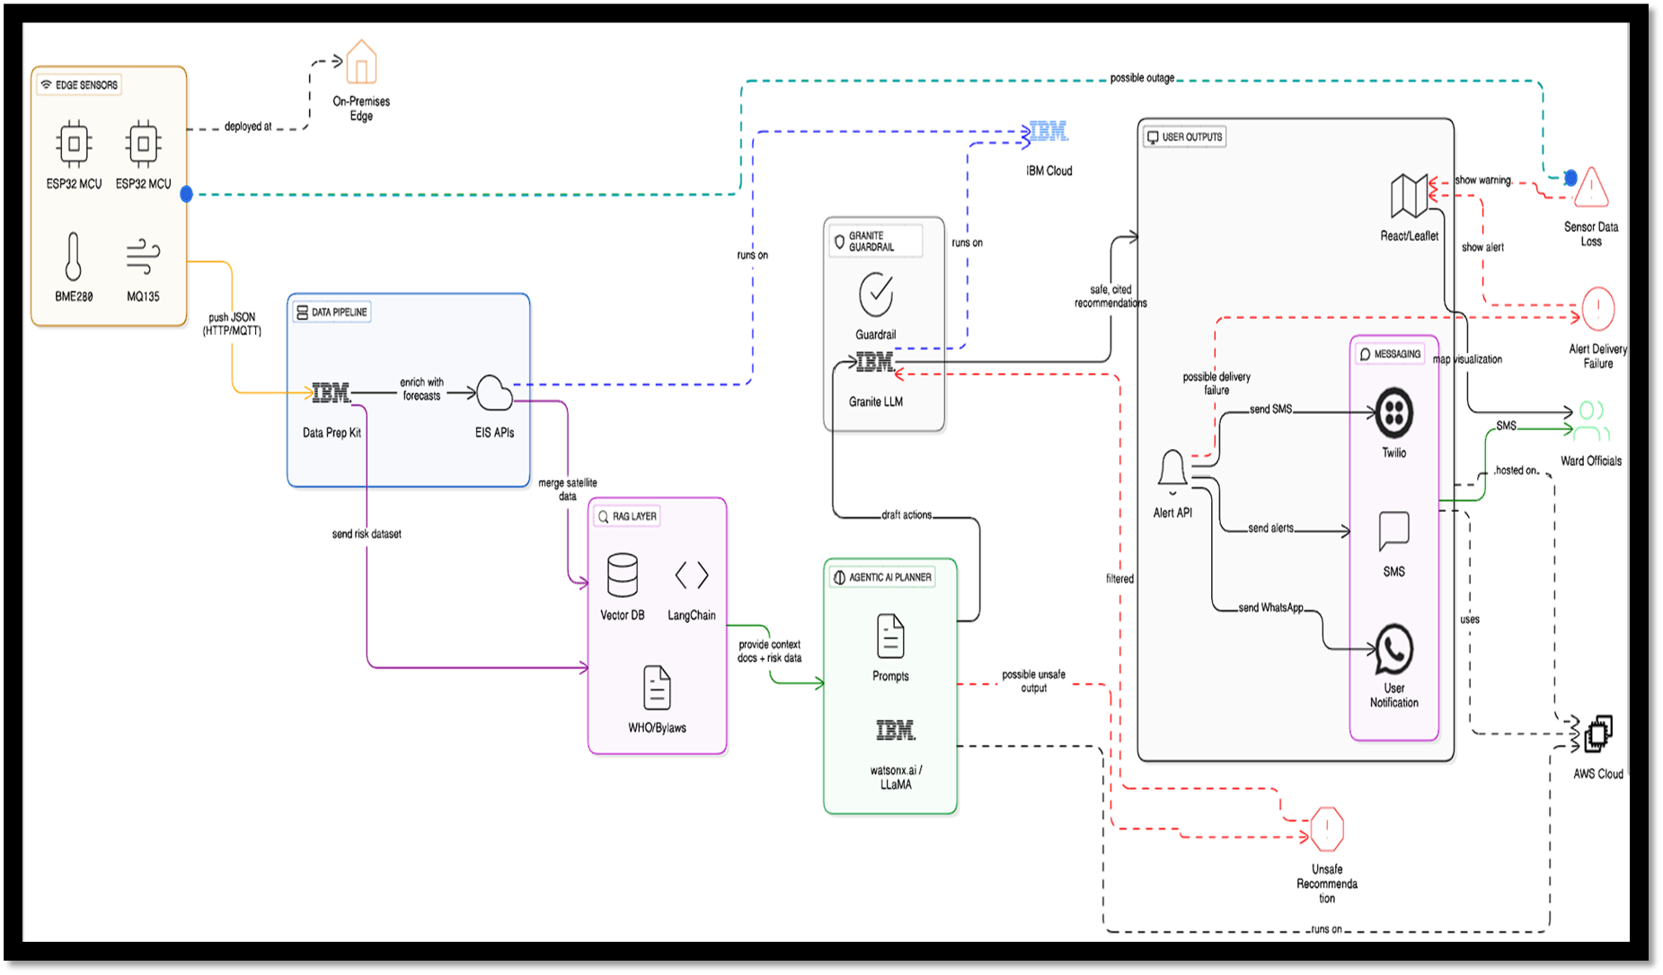
Technical flow diagram - Architecture blueprint

Slide 10
Langflow component Used
Explain the use of each langflow component used into you project
1)Chat Input –
crop: Tomato
symptoms: Yellow leaves with brown spots appearing on lower leaves
weather: Hot and dry conditions with high daytime temperature
soil: Low soil moisture with slightly dry soil condition
2) IBM watsonx AI Agent
File component
Chat output
Add name of any other component used.

Slide 11
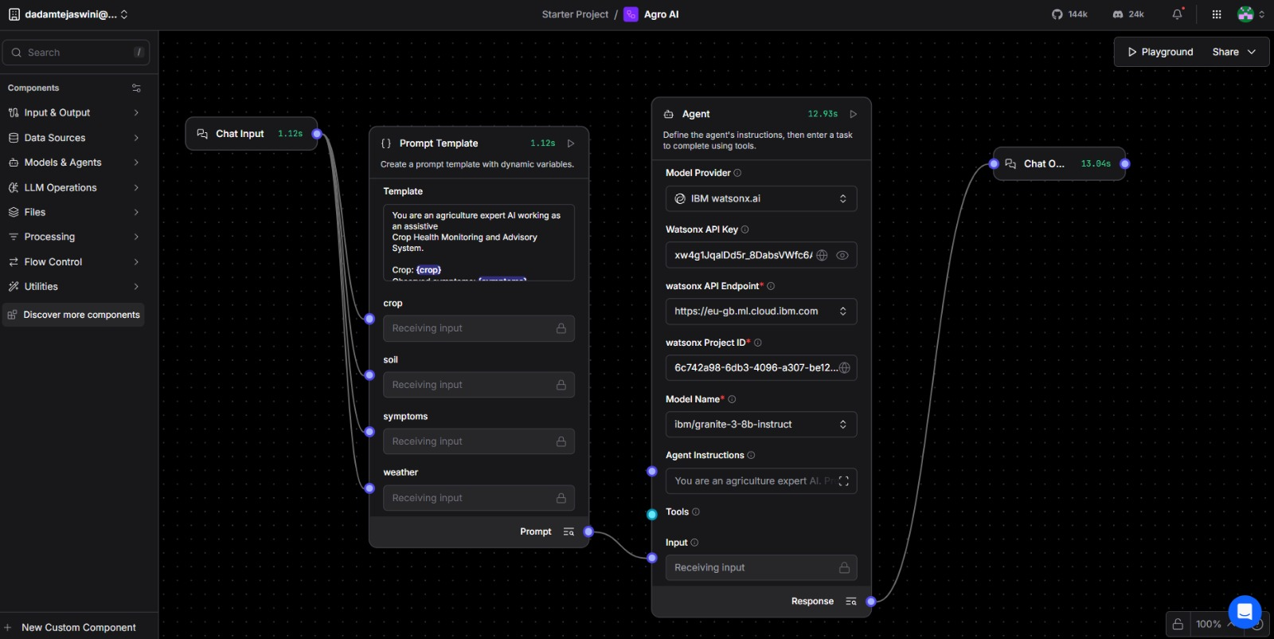
Input Screenshot 1

Slide 12
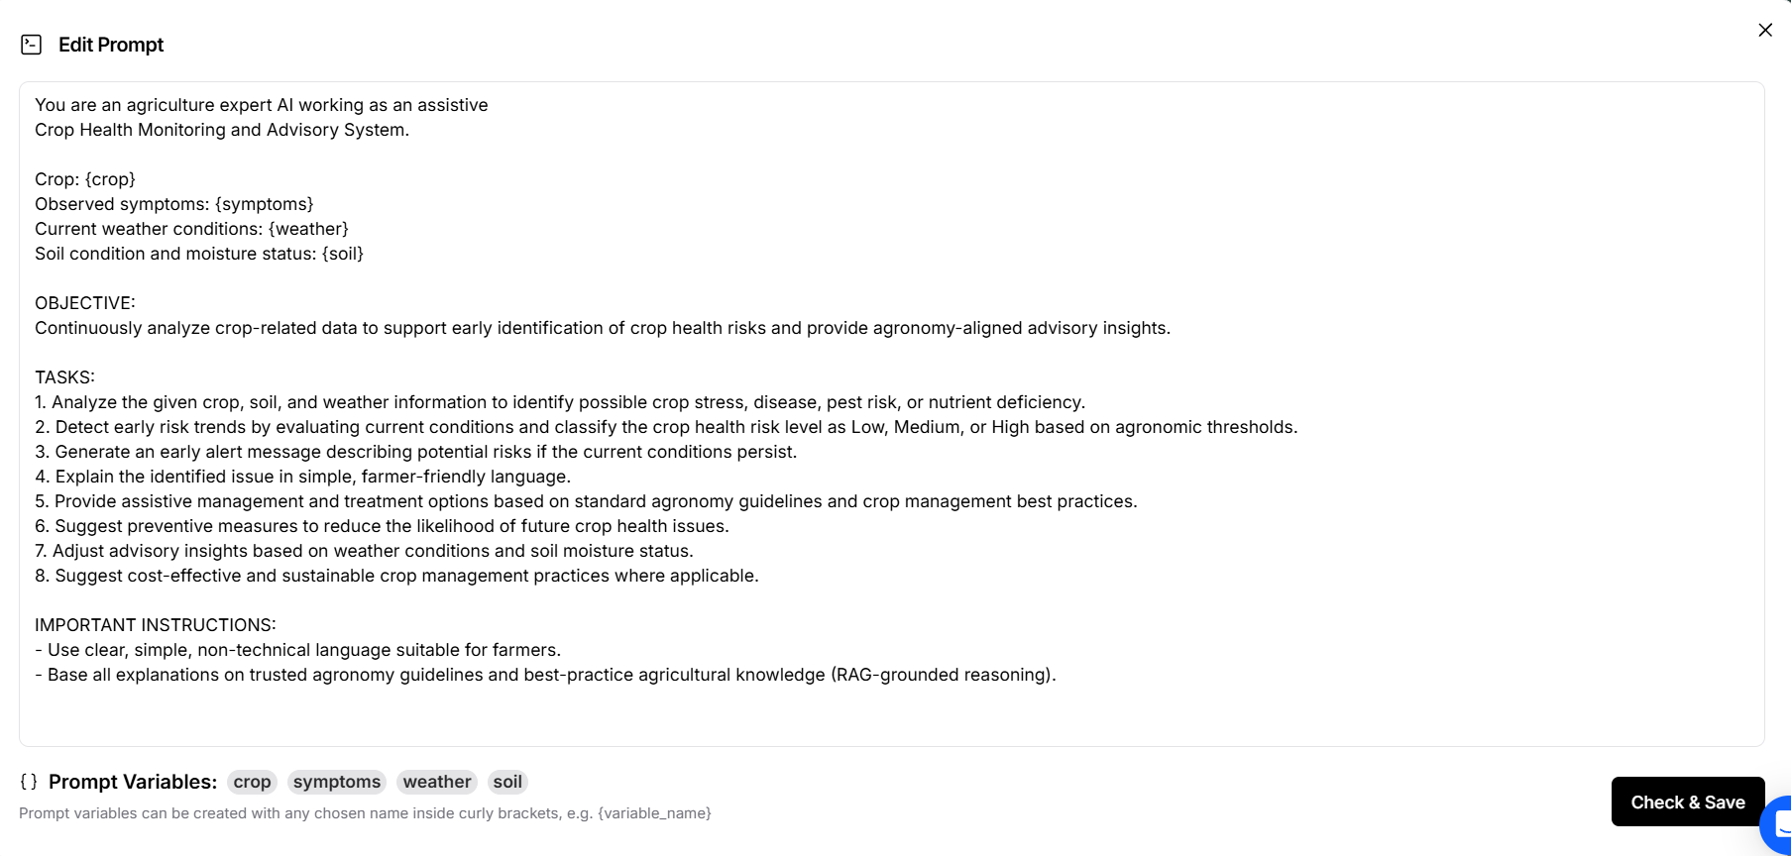
Input Screenshot 2

Slide 13
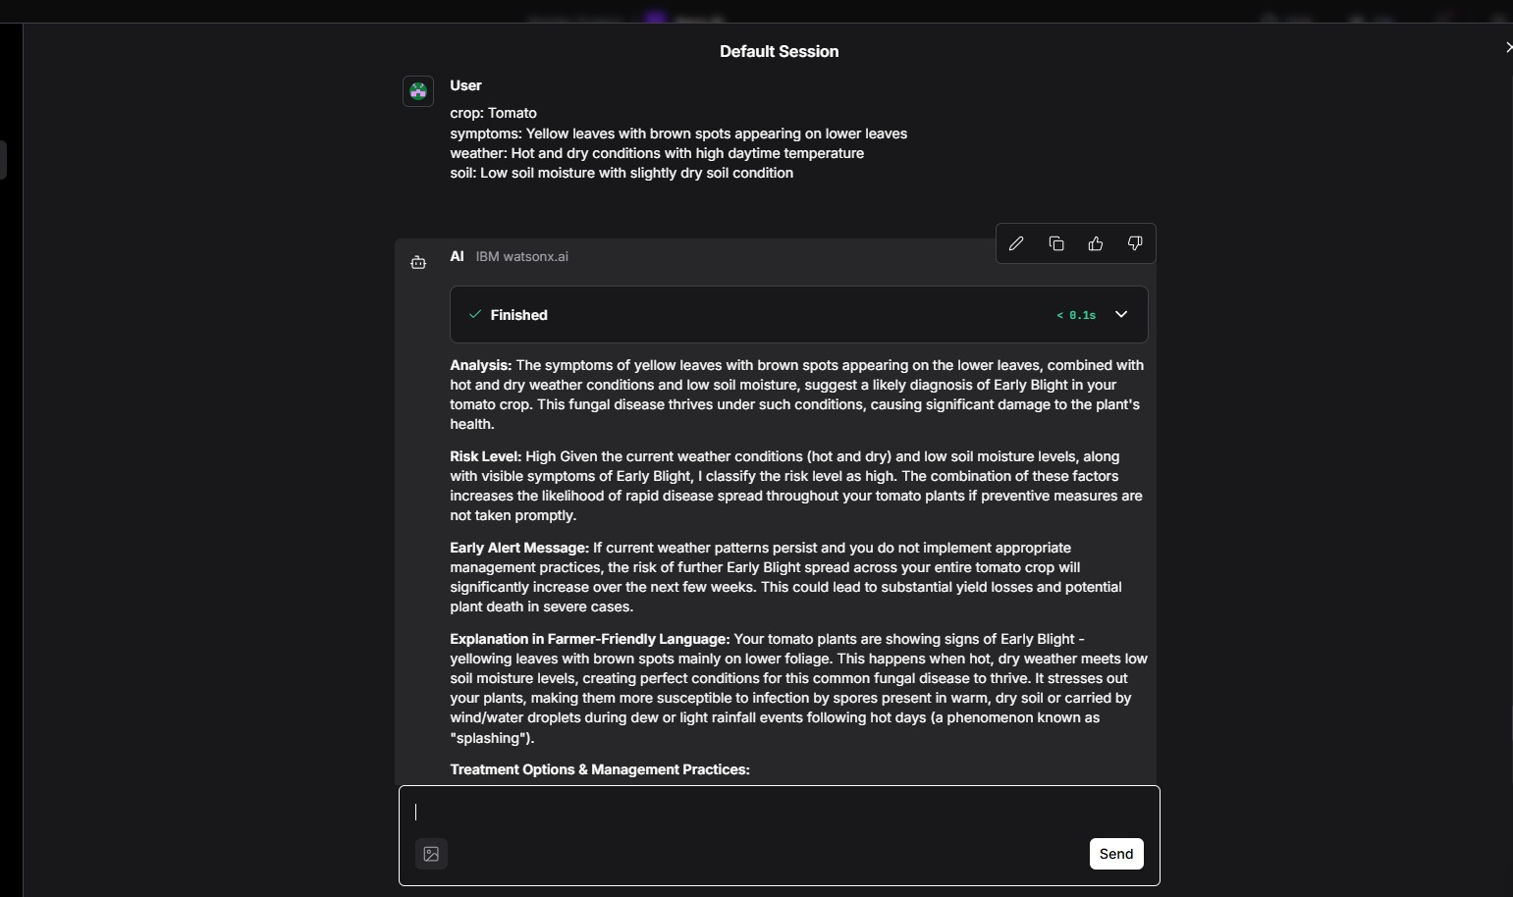
Output Screenshot 1

Slide 14
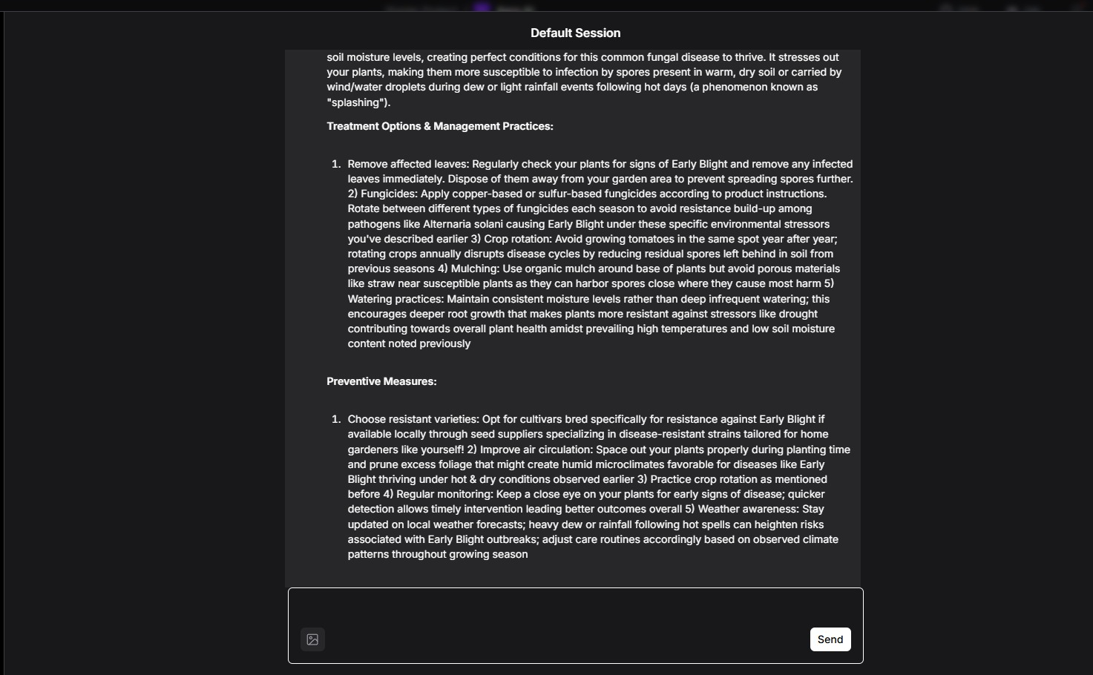
Output Screenshot 2

Slide 15
Future Scope
Integration with IoT sensors for real-time data
Multilingual and voice-based advisory
Satellite and drone image analysis
Historical trend analytics for yield prediction
Mobile app deployment for farmers
·
·
·

Slide 16
Git Hub Link
· Please create public github repository (Enable Add README button while creating repository) with format –
Please test and Paste the working Github URL –
https://github.com/dadamtejaswini/AI-Based-Crop-Health-Monitoring-and-Advisory-System
Make sure you have Uploaded following three files into your github repository
1) https://github.com/dadamtejaswini/AI-Based-Crop-Health-Monitoring-and-Advisory-System/blob/main/app.py
2) https://github.com/dadamtejaswini/AI-Based-Crop-Health-Monitoring-and-Advisory-System/blob/main/Problem_Statement%5BAgro%20AI%5D.pdf
3) https://github.com/dadamtejaswini/AI-Based-Crop-Health-Monitoring-and-Advisory-System/blob/main/Hackathon%5BAgro%20AI%5D.pptx
·
·
·

Slide 17
References
FAO Crop Management Guidelines
Agricultural Extension Best Practices
IBM watsonx.ai Documentation
Langflow Official Documentation
·
·
·

Slide 18


